Slide 1

Provably Secure Steganography
Presented by Brian Vohaska and Chaka Hazelwood

Slide 2
What is Steganography?

Slide 3
Basic Premise of Steganography
Steganography is the process of sending a secret (encrypted) message in a manner such that no other external entity can detect that a secret message has been being sent.
Basically, steganography is the hiding of the message being sent.

Slide 4
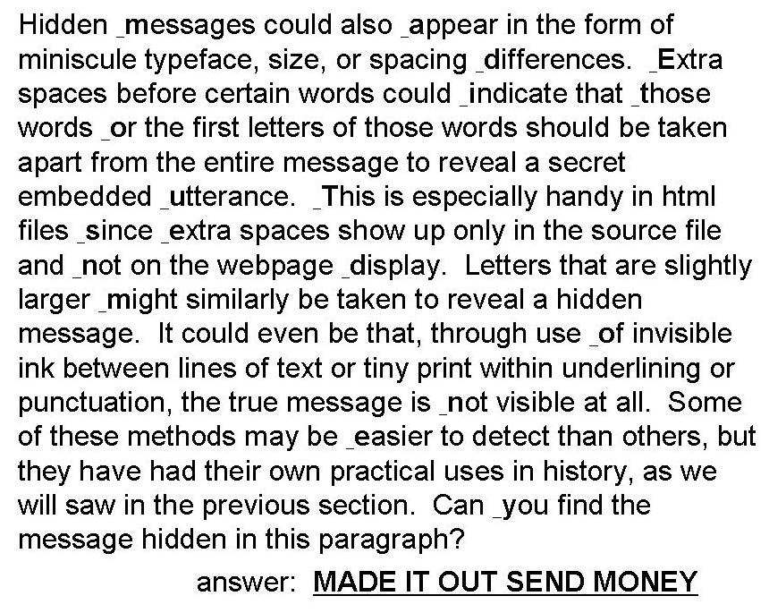
Examples

Slide 5
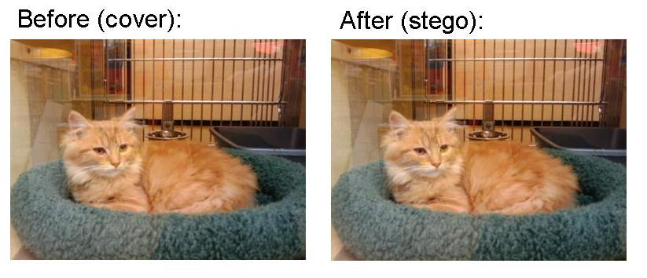
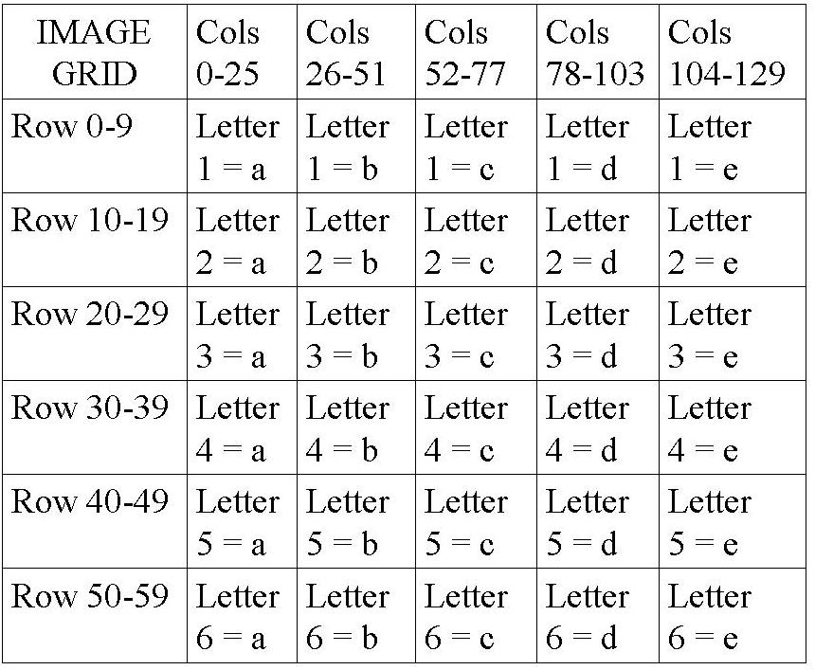
Examples
Photo Image With Added Noise Test
Even pixels: 136193 original and 136185 encoded
Odd pixels: 137419 original and 137427 encoded

Slide 6
Cryptography vs. Steganography
Cryptography – Hide the contents of a message.
Steganography – Hide the existence of the message.

Slide 7
Let’s Play A Game…
Scenario
You are a prisoner in the most secure prison in the universe. No one has ever escaped this prison since its inception inaugural operation. However, you know something that no one else knows…and that’s how you will escape!
But there’s a catch…
Your friend/brother/sister/lover (pick a person) is also in this prison and you need to convey the plans of escape to them so they can escape.
shit…the Warden is paranoid and intensely looks for any secret messages
How do you convey your plans so that the Warden, W doesn’t detect your message and double your sentence?

Slide 8

STEGANOGRAPHY!!!!
(provable kind; not that weak sauce YOLO kind that l33t hax0r script kiddies use #tracerT)
That’s how

Slide 9
Some Formalities

Slide 10

A few provisos
PRF definition
Hiddentext definition
Channel & Message Oracle
Rejection sampling
What is security for stegosystems

Slide 11
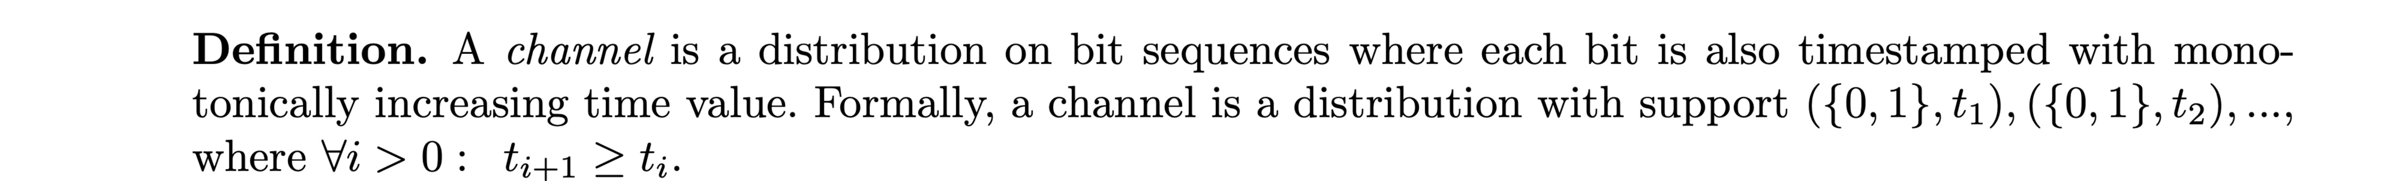
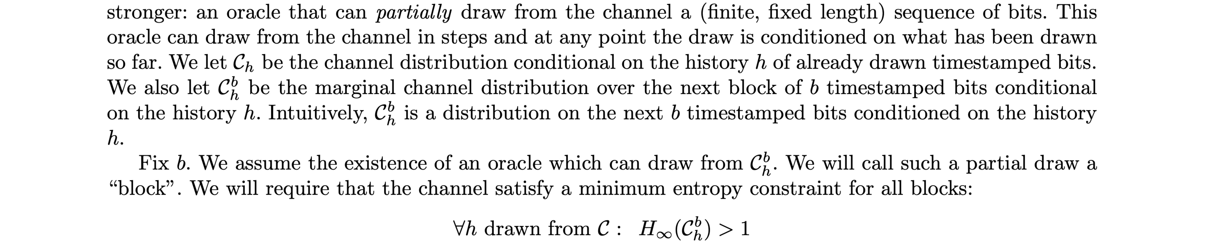
Channels, Entropy, and Oracles
Examples:
Twitter
QR Codes
Basically, any data stream with some entropy so we can mess around

Slide 12
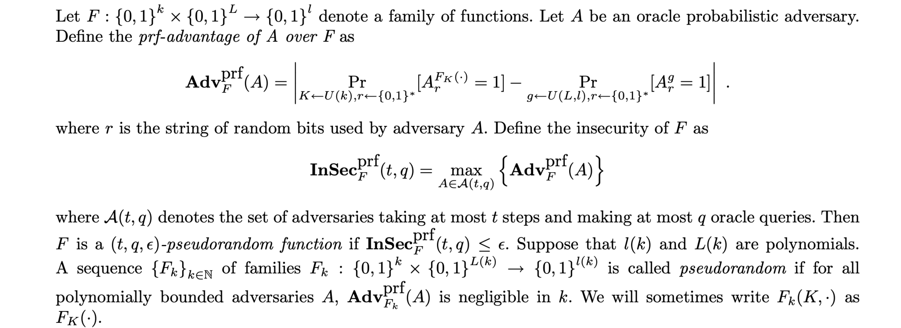
Quick thing about PRFs

Slide 13
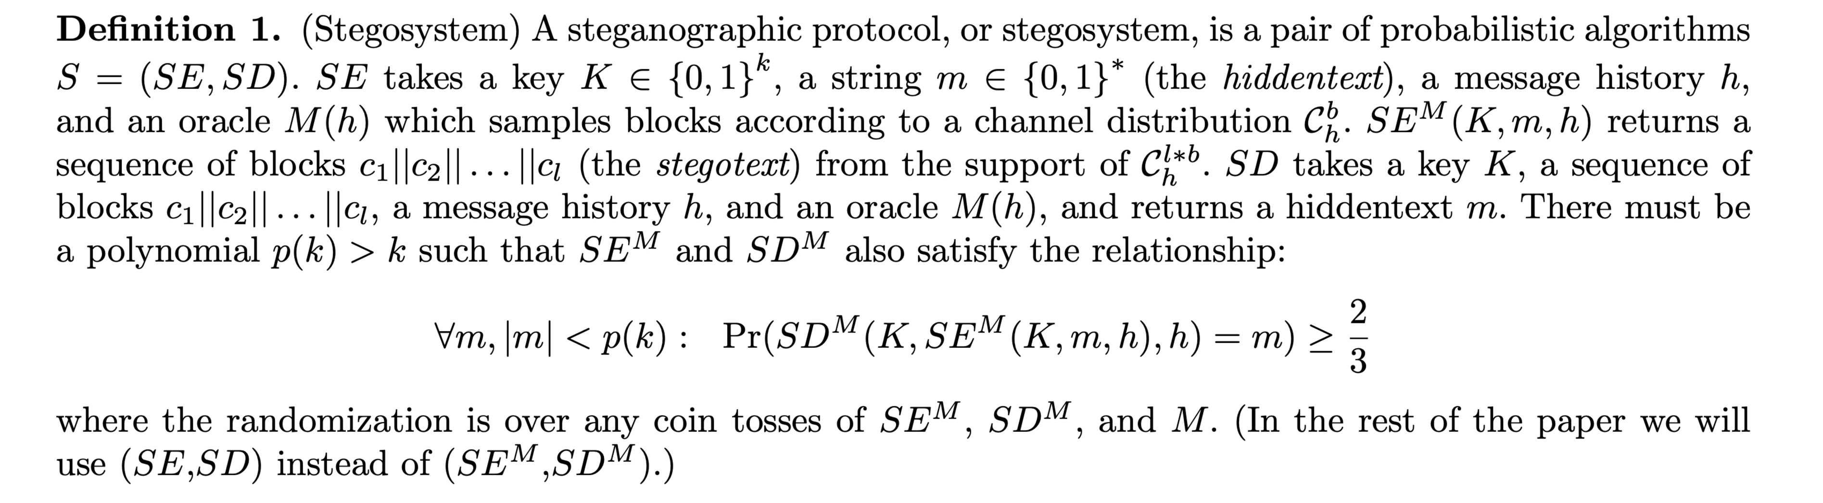
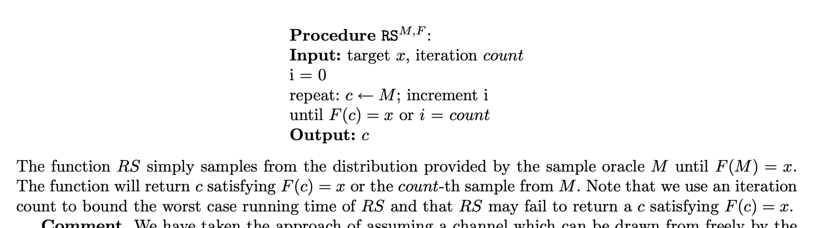
The Stegosystem
Rejection Sampling
(This will matter later)

Slide 14
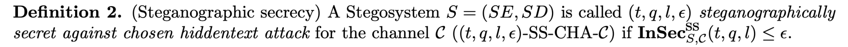
The Thesis: Steganographic Secrecy
Defined as (roughly)
Encryption which is indistinguishable from arbitrary distributions for the channel C.

Slide 15
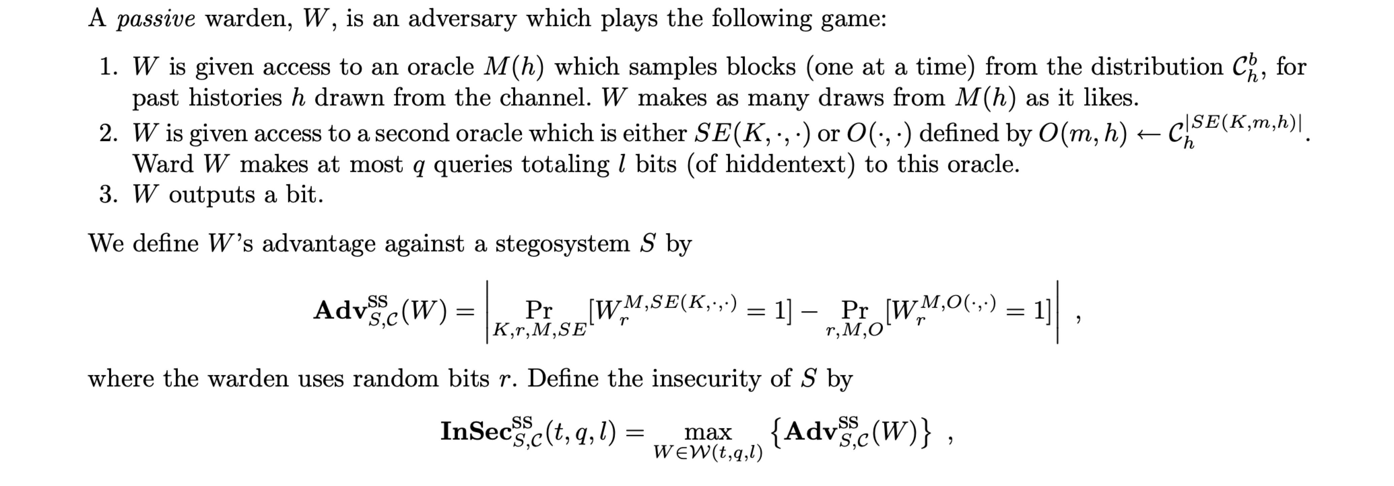
The Security Game

Slide 16
So… What does this thing look like?

Slide 17
Construction: Stateful Universal Steganographic Secrecy
Assume you and your friend/brother/sister/lover (pick a person) share a channel and let C denote the channel distribution. Let M(h) be an oracle which draws blocks (one at a time) from the conditional distribution C b h.
Let FK(·, ·) denote a pseudorandom function family indexed by k = |K| key bits which maps a pair consisting of a d-bit number and b timestamped bits to the set {0, 1}, i.e., F : {0, 1} k × {0, 1} d × ({0, 1}, t) b → {0, 1}.
Let you and your friend/brother/sister/lover (pick a person) share a secret key K ∈ {0, 1} k and a synchronized d bit counter N. Let Enc and Dec be the encoding and decoding procedures, respectively, for an error-correcting code which corrects up to a 3/8+InSecprf F (O(l), 2l) fraction of errors, and which has stretch function `(·).
The following procedures allow Alice and Bob to encode and decode a hiddentext and to send it via their shared channel.

Slide 18
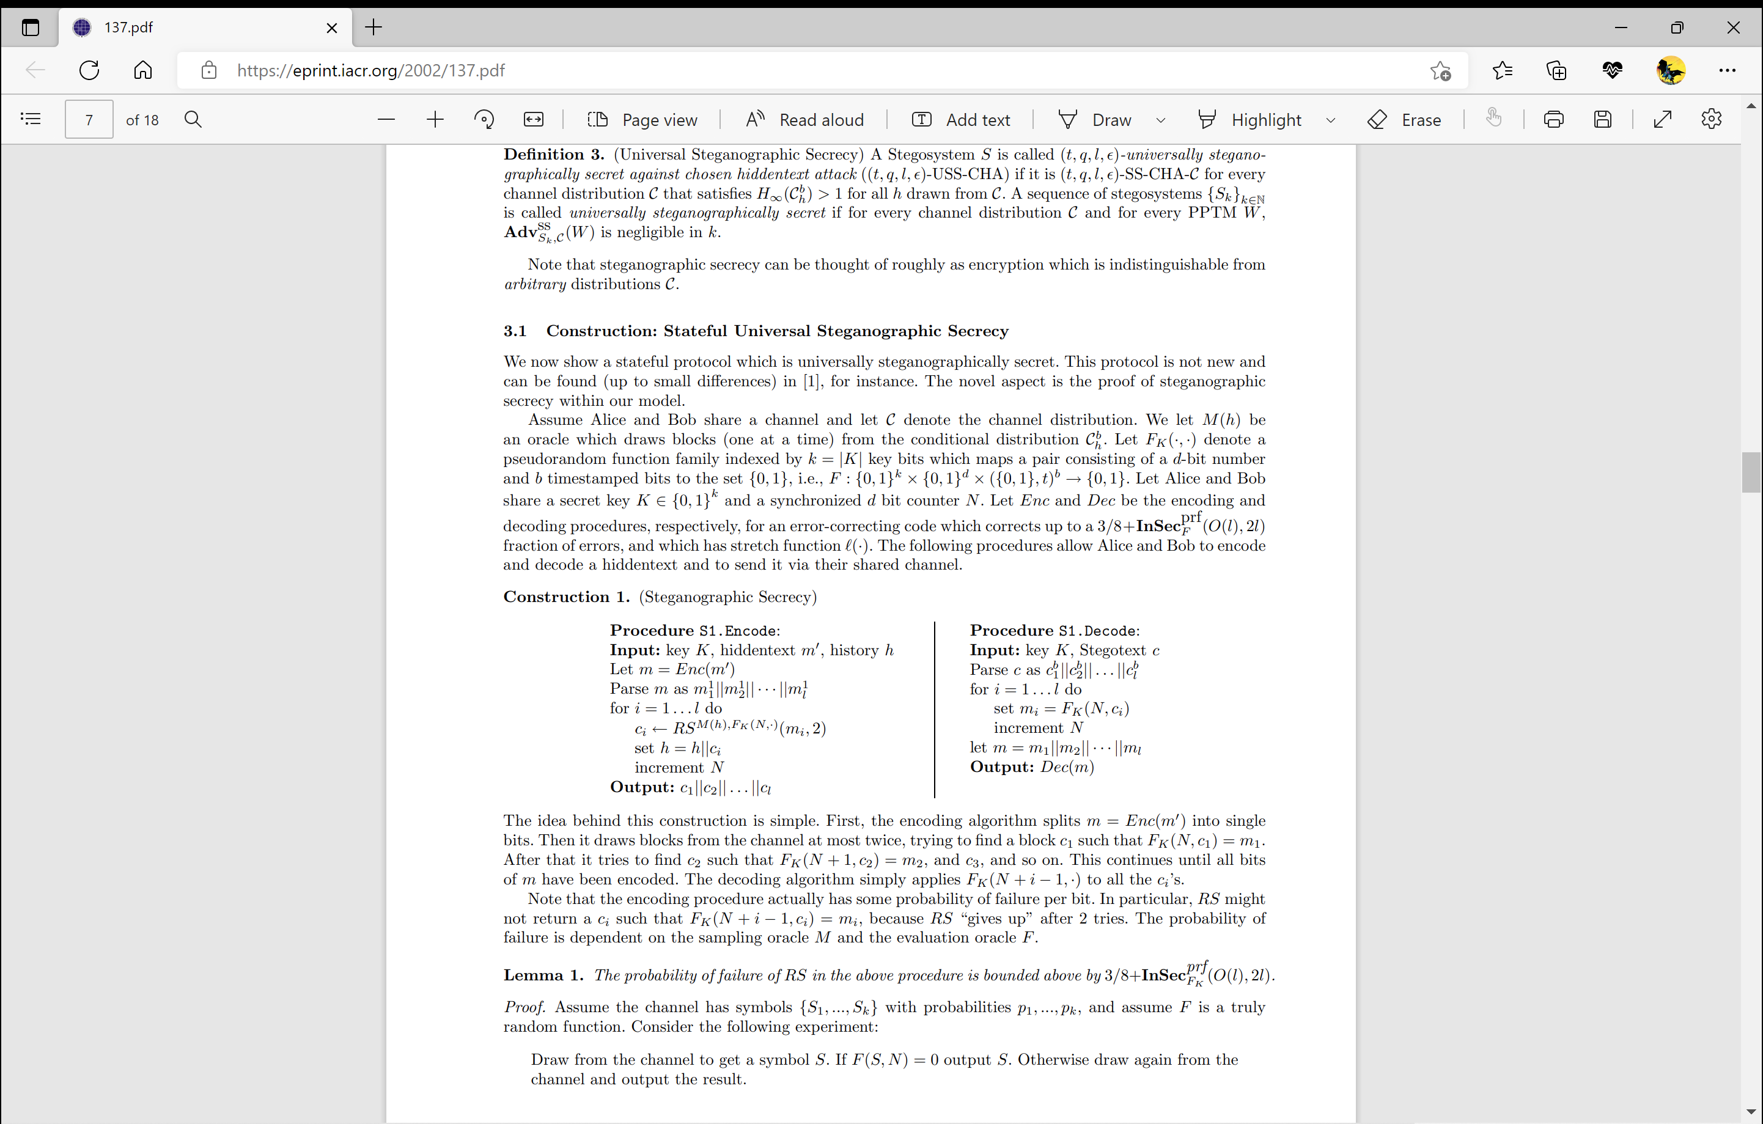
Construction: Stateful Universal Steganographic Secrecy

Slide 19
Construction: Stateful Universal Steganographic Secrecy
Basically,
We break the message we want to send into smaller parts. These smaller parts are outputted as c.
We then concatenate these smaller parts to past histories h, which are drawn from the channel C, via oracle/Reject Sampling function, RS.
Once all the parts of the message are sent, we combine all the message parts, c.
The combined message parts, c, form message, m, which we then decode to get the message.

Slide 20
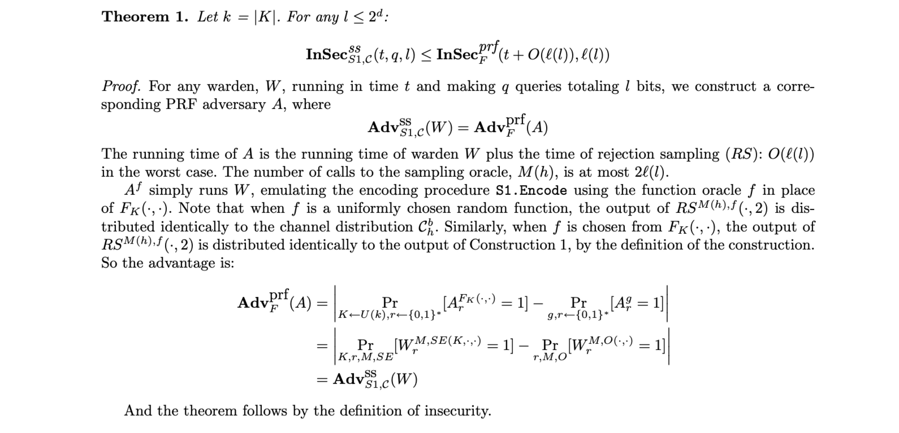
Security Proof (USS is at least as secure as a PRF)

Slide 21
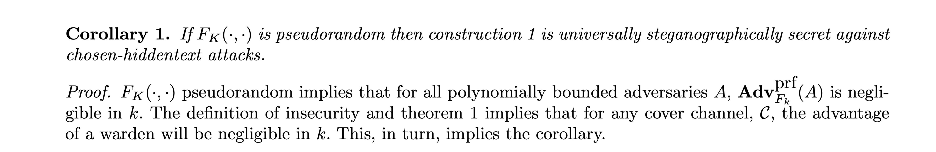
Security Proof (USS is secure against CHA)

Slide 22
References
Provably Secure Steganography
Nicholas J. Hopper, John Langford, and Luis von Ahn
September 6, 2002 CMU-CS-02-149 School of Computer Science
Carnegie Mellon University Pittsburgh, PA 15213

Slide 23
Can we implement this? lol, yes. gg2ez

